Slide 1
Using the Data Assimilation Research Testbed for Climate System Applications Jeff Anderson (and many collaborators), NCAR/CISL

Slide 2
The Data Assimilation Research Testbed (DART)
DART provides data assimilation ‘glue’ to build ensemble forecast systems for the atmosphere, ocean, land, …
Prediction Model
Observing System
DART
Analysis

Slide 3
Data Assimilation Research Testbed (DART)
A state-of-the-art Data Assimilation System for Geoscience
Flexible, portable, well-tested, extensible, free!
Works with many models.
Works with any observations: Real, synthetic, novel.
A Data Assimilation Research System
Theory based, widely applicable general techniques.
Localization, Sampling Error Correction, Adaptive Inflation, …
Professionally software engineering
Carefully constructed and verified
Excellent performance
Comprehensive documentation
People: The DAReS Team
Notes:
Code: well-tested, portable, extensible
Models: toy- to HUGE
Observations: real, synthetic, novel
An extensive Tutorial: examples, exercises, explanations
People: images of all of us

Slide 4













DART is used at:
48 UCAR member universities,
More than 100 other sites,
(More than 1500 registered users).
Notes:
Code: well-tested, portable, extensible
Models: toy- to HUGE
Observations: real, synthetic, novel
An extensive Tutorial: examples, exercises, explanations
People: images of all of us

Slide 5
DART Accelerates Forecast System Development
Works with nearly all NCAR community models (dozens of other models, too).
New models can be added in weeks.
Adding new observations is even easier.
Modular: models, observations and assimilation tools easily combined.
Enables DA use by prediction scientists.
Doesn’t require assimilation expertise.
Fast & efficient software: laptops to supers.

Slide 6
Example: NCAR Real-time ensemble prediction system
Notes:
Examples of forecast probabilities of daily hazardous local storms during June 2015 from NCAR’s real-time ensemble prediction system. These results are based on NCAR’s Data Assimilation Research Testbed (DART) and a high resolution version of the Weather Research and Forecast model (WRF) to produce forecasts of severe storm events. In this study a 10-member ensemble is used to identify representations of individual storm hazards. These are then combined to generate probabilistic severe storm guidance for a 24-hour forecast period. Higher probabilities (warmer fill colors) indicate a higher forecast probability of hazardous storms occurring within a particular region. The two plots in this figure illustrate different distributions of severe storm events for the U.S., highlighting the range of skill that these ensemble forecasts have in predicting high-impact weather events. Overlain in black polygons are areas where local National Weather Service (NWS) forecast offices issued either tornado or severe thunderstorm warnings. Probabilistic forecasts of weather hazards based on ensembles is an active area of research, and this study evaluates how some new measures of severe weather vary over the full area of the the conterminous United States. In particular, this work is novel in using a regional-scale ensemble method as the initial conditions to make the forecasts, and also in using new diagnostics to assess the forecast skill. Future activities planned for the ensemble system include plans to compare this work to the operational GSI system and to consider forecasting winter weather hazards.
----- Meeting Notes (5/4/16 11:08) -----
high res. last bullet key.
coloring is probability of severe weather. black is predictions from NWS. Future work to understand predictability. "Forecast skill" - early days.

Slide 7
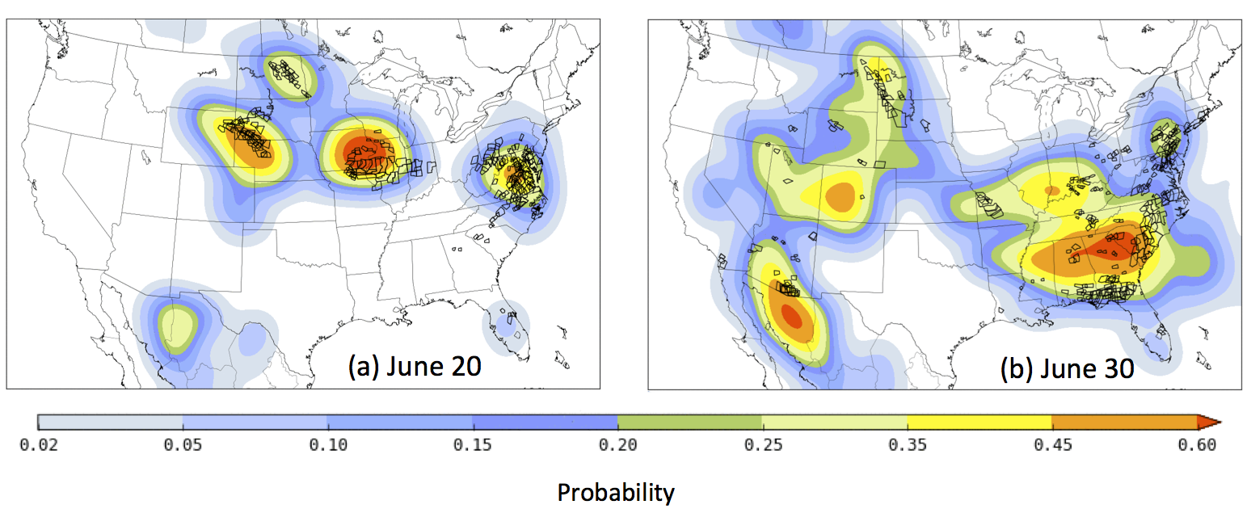
Example: NCAR Real-time ensemble prediction system
Severe weather forecast for two days compared to NWS warnings
WRF, 10 member ensemble, GFS for boundary conditions
Continuous operation since April, 2015
48 hour forecasts at 3km resolution
First continuously cycling ensemble system for CONUS
Notes:
Examples of forecast probabilities of daily hazardous local storms during June 2015 from NCAR’s real-time ensemble prediction system. These results are based on NCAR’s Data Assimilation Research Testbed (DART) and a high resolution version of the Weather Research and Forecast model (WRF) to produce forecasts of severe storm events. In this study a 10-member ensemble is used to identify representations of individual storm hazards. These are then combined to generate probabilistic severe storm guidance for a 24-hour forecast period. Higher probabilities (warmer fill colors) indicate a higher forecast probability of hazardous storms occurring within a particular region. The two plots in this figure illustrate different distributions of severe storm events for the U.S., highlighting the range of skill that these ensemble forecasts have in predicting high-impact weather events. Overlain in black polygons are areas where local National Weather Service (NWS) forecast offices issued either tornado or severe thunderstorm warnings. Probabilistic forecasts of weather hazards based on ensembles is an active area of research, and this study evaluates how some new measures of severe weather vary over the full area of the the conterminous United States. In particular, this work is novel in using a regional-scale ensemble method as the initial conditions to make the forecasts, and also in using new diagnostics to assess the forecast skill. Future activities planned for the ensemble system include plans to compare this work to the operational GSI system and to consider forecasting winter weather hazards.
----- Meeting Notes (5/4/16 11:08) -----
high res. last bullet key.
coloring is probability of severe weather. black is predictions from NWS. Future work to understand predictability. "Forecast skill" - early days.

Slide 8
DART Applications with CESM Earth System Models
DART interfaces exist for many components of NCAR’s Community Earth System Model:
Lower atmosphere: CAM-FV, CAM-SE, MPAS
Upper atmosphere, ionosphere: WACCM, WACCMX
Atmospheric Chemistry: CAM/Chem
Ocean: POP
Land surface / biosphere: CLM
Sea Ice: CICE
Weakly coupled DA combinations of the above

Slide 9
Deep Atmospheric Component Coupled DA
DART
Atm Obs
3D state
3D restart
WACCMX
Results from N. Pedatella, H. Liu, J. Liu
2D forcing
Coupler

Slide 10
Deep Atmospheric Component Coupled DA
WACCMX:
2 degrees, 126 levels, top at 4.1x10⁻¹⁰ hPa
High-top extension of CAM
Includes ionospheric processes
Persistence forecasts of solar and geomagnetic forcing
Observations:
All in situ plus GPS refractivity in trop/lower strat.
Temperature from AURA Microwave Limb Sounder (MLS)
Temperature from TIMED/SABER
Temperatures only up to 100km
DART:
40 members
Adaptive inflation, GC localization
6-hour window

Slide 11
Deep Atmospheric Component Coupled DA
Impact of SSW on ionosphere
Forecast (top panel), reanalysis (middle), and independent obs of Total Electron Content.
Agreement of forecast with observations indicates significant prediction skill.

Slide 12
Multiple Component POP/CAM Coupled DA
Atm Obs
CAM/DART
Ocn Obs
CAM
POP
Coupler
CICE
POP/DART
CLM
Multiple components assimilating with different DART(s) in fully-coupled CESM.
Results from A. Karspeck

Slide 13
Multiple Component POP/CAM Coupled DA
Weakly coupled reanalysis from 1970-1981
Model:
POP, 1 degree, standard CESM configuration
CAM-FV, 1 degree, standard CESM configuration
Observations:
In-situ atmosphere observations from NCEP reanalysis
Ocean temperature and salinity, World Ocean Database
DART:
30 members
Limited adaptive inflation in ocean
Fully adaptive inflation in atmosphere
GC localization

Slide 14
Multiple Component POP/CAM Coupled DA
Observations are sparse for this period.

Slide 15
Multiple Component POP/CAM Coupled DA
Comparisons to HADISST and HADSLP.
Correlation high where observations existed.
DART did not assimilate SST products or observations.
Produces competitive reanalysis.

Slide 16
Tropospheric Chemical Weather DA
Atm, Chem Obs
DART
3D state
3D restart
CAM/
Chem
Results from B. Gaubert, J. Barre
2D forcing
Coupler

Slide 17
Tropospheric Chemical Weather DA
Chemical Weather Reanalysis for Summer 2008
Model:
CAM-FV 2 degree 30 levels
Mozart-4 tropospheric chemistry
Observations:
In-situ atmosphere observations from NCEP reanalysis
MOPITT and IASI CO retrieved profiles
DART:
30 members
Adaptive inflation
GC localization, more localized for CO obs

Slide 18
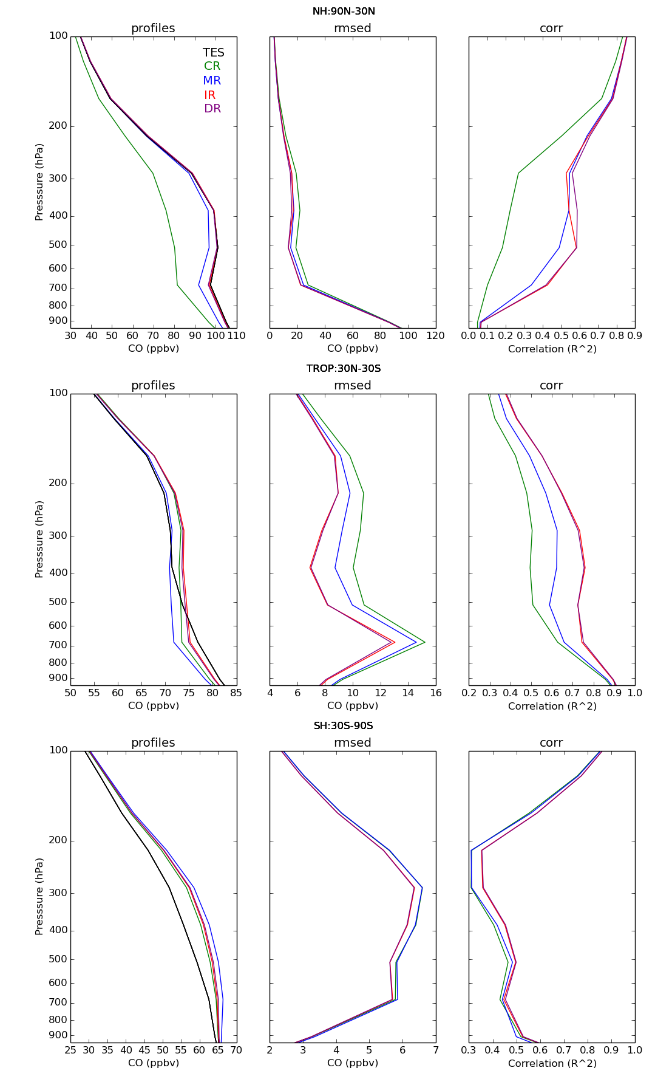
Tropospheric Chemical Weather DA
CO forecast fits to observations improved with DA.
Comparison to independent TES CO obs greatly improved.

Slide 19
CLM Land Component Coupled DA
Land Obs
DART
3D state
3D restart
CLM
2D forcing
Coupler

Slide 20

Some of the researchers using CLM/DART
Yong-Fei Zhang (UT Austin)
multisensor snow data assimilation
Andy Fox (NEON)
flux observations/state estimation
Hanna Post (Jülich)
assimilation & parameter estimation
Raj Shekhar Singh (UC Berkeley)
groundwater
Long Zhao (UT Austin)
AMSR-E radiances, empirical vegetated surface RTM, soil moisture (SMAP)
Ally Toure (NASA-Goddard USRA)
brightness temperatures
Yonghwan Kwon (UT Austin)
sensitivity of assimilation of brightness temperatures from multiple
radiative transfer models on estimates of snow water equivalent.
Notes:
For the past months, I have been trying to assimilating AMSR-E radiance (Descending orbit, 10.6 GHz, H- and V- polarization) into CLM to estimate global soil mositure (1.25 degree x 0.9 degree). Thanks to your help, up to now, I have already successfully coupled an empricial vegetated-surface radiative transfer model into DART-CLM, prepared all the input datasets, and got the assimilation run effectively (with 20 ensembles for test run). Currently, I am working on some technical problems and testing the system as well. I will keep you updated on the first results together with more details on what I have done within the following weeks.
Wish you all the best,
Sincerely,
Long

Slide 21

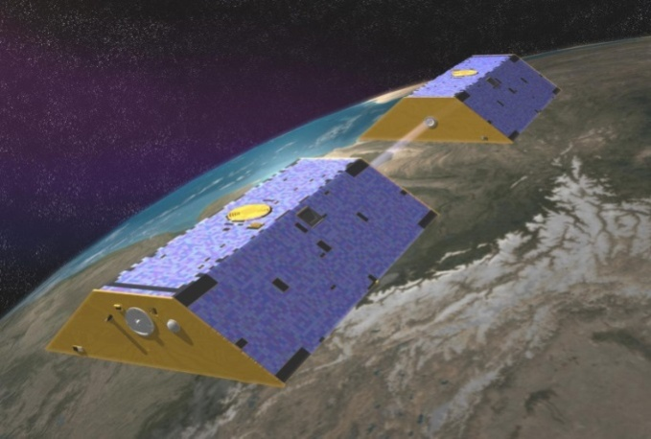
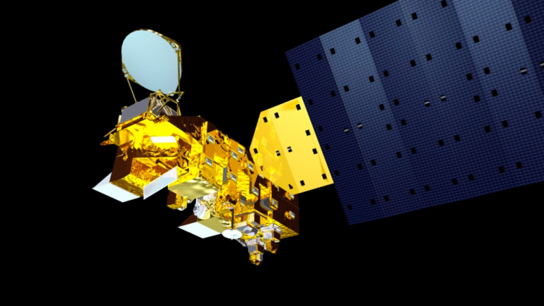




Improving Estimates of Snowpack Water Storage in the Northern Hemisphere Through a Newly Developed Land Data Assimilation System
Yong-Fei Zhang¹, Zong-Liang Yang^{1,2}, Yonghwan Kwon¹, Tim J. Hoar³, Hua Su¹, Jeffrey L. Anderson ³, Ally M. Toure ^{4,5}, and Matthew Rodell ⁵
¹Jackson School of Geosciences, University of Texas at Austin, Austin, TX, United States.
²Key Lab of Regional Climate-Environment for Temperate East Asia (RCE-TEA), Institute of Atmospheric Physics, Chinese Academy of Sciences, Beijing, China.
³The National Center for Atmospheric Research, Boulder, CO, United States.
⁴Universities Space Research Association (USRA), Columbia, MD, United States.
⁵NASA Goddard Space Flight Center, Greenbelt, MD, United States.

Slide 22
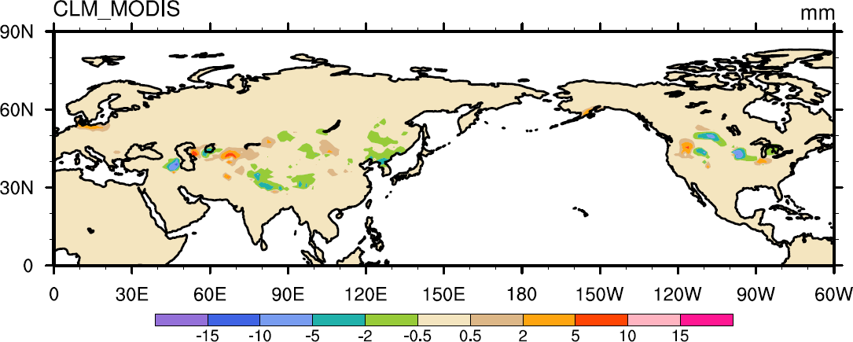
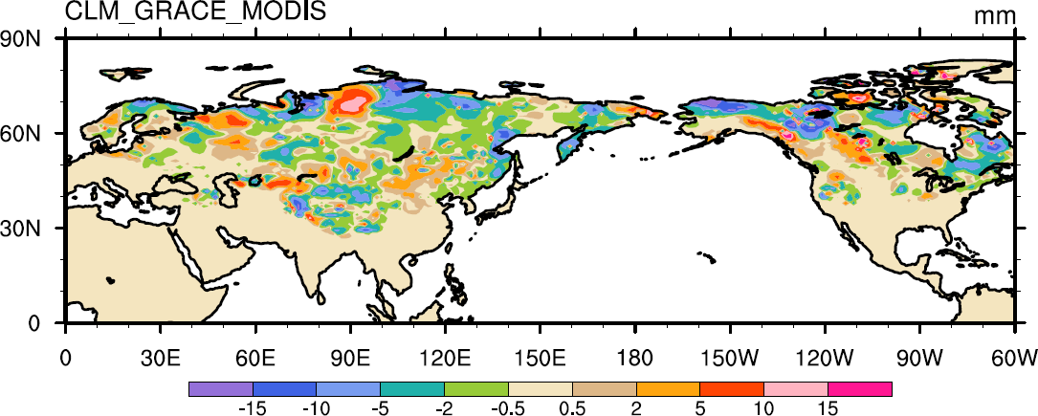
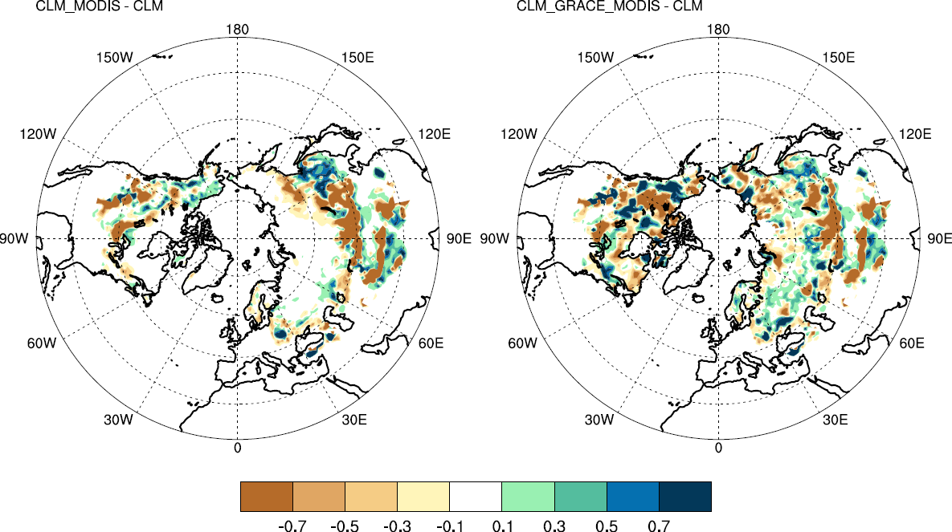
Assimilation Results
Snow Water Storage (Posterior minus Prior)
MODIS assimilation
MODIS and GRACE assimilation

Slide 23
CICE Sea Ice Component Coupled DA
Ice Obs
DART
3D state
3D restart
CICE
2D forcing
Coupler
Results from C. Bitz, Y. Zhang

Slide 24
CICE Sea Ice Component Coupled DA
Sea Ice OSSE
Model:
CICE-5 forced by slab ocean
Atmospheric forcing from CAM ensemble reanalysis
Observations:
Sea ice concentration, age, thickness
DART:
30 members
Adaptive inflation
GC localization

Slide 25
CICE Sea Ice Component Coupled DA
OSSE used to explore information content of different obs.
Sea ice concentration alone not as good as when combined with age or thickness observations.
RMSE of Thickness

Slide 26
CICE Sea Ice Component Coupled DA
Sea ice concentration from SSM/I retrievals as next step.
Reanalysis is moved much closer to observed concentration.

Slide 27
What might DA do for climate model applications?
ICs for predictions,
Produce reanalyses to help increase understanding,
Confront models with observations, find inconsistencies
(but almost never gives direct path to improving model),
Parameter estimation for model ‘tuning’.
Ensemble methods can provide information about uncertainty (and other aspects of distributions) for all of these.

Slide 28
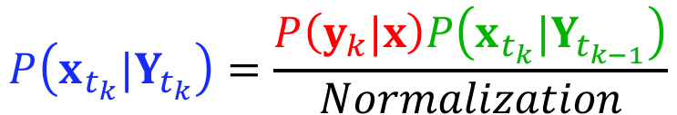
DA Challenges for All Applications
Many assumptions of Bayesian theory are violated:
Unbiased model and observations,
Uncorrelated observation errors,
Exact estimates of observation error distribution,
Exact estimates of representation error.
Prior (forecast)
Likelihood
Posterior (analysis)
$$P\left(x_{t_{k}}|Y_{t_{k}}\right)=\frac{P\left(y_{k}|x\right)P\left(x_{t_{k}}|Y_{t_{k−1}}\right)}{Normalization}$$

Slide 29
DA Challenges for All Applications
For Kalman Filter class algorithms following are violated:
Gaussian priors and observation errors,
Linear relation between model state and observations.
For Ensemble Kalman filter algorithms add:
Sufficiently large ensembles,
Model provides accurate estimates of second moments.

Slide 30
DA Challenges for All Applications
Because of all these violations of assumptions, there is no way to assess the quality of DA results a priori.
It is essential to calibrate and validate DA results.
This is even true for very mature NWP systems.
For novel climate system applications it is even more vital.
Requires lots of observations spanning many decorrelation times for model dynamics.

Slide 31
DA Challenges for All Applications
Calibration and validation must include ensemble statistics.
This requires even more observations.
Ensemble statistics aside from 1st, 2nd moment are suspect.
Kalman filter does not generate estimates of these.
Not clear why ensemble Kalman filters should.

Slide 32
DA Challenges for All Applications
Non-equilibrium ”off attractor” model evolution.
E.g., spurious numerical gravity waves in NWP.
DA can cause state variables not found in free runs.
These can challenge the model numerics.
Example from WACCMX:
Model damping and diffusion had to be increased to reduce gravity wave amplitude with DA.

Slide 33

DA approximates solutions to this problem
This may be inconsistent with what modelers expect.
Example: Parameter estimation for gravity wave drag in CAM.
Estimate surface roughness at each horizontal gridpoint.
Result was a very bumpy tropical Pacific, with improved forecasts.
Unless known exactly, ‘conserved’ quantities shouldn’t be conserved.
$$P\left(x_{t_{k}}|Y_{t_{k}}\right)=\frac{P\left(y_{k}|x\right)P\left(x_{t_{k}}|Y_{t_{k−1}}\right)}{Normalization}$$

Slide 34
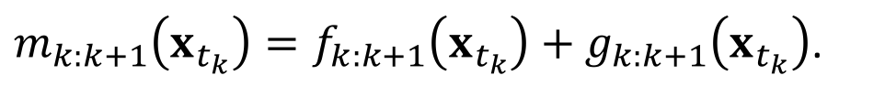
DA Challenges for Earth System Component Models
$$P\left(x_{t_{k}}|Y_{t_{k}}\right)=\frac{P\left(y_{k}|x\right)P\left(x_{t_{k}}|Y_{t_{k−1}}\right)}{Normalization}$$
DA requires a (stochastic) forecast model:
When applied to a correct analysis distribution ensemble at a previous time, model should produce a correct forecast ensemble distribution for subsequent observations.
$m_{k:k+1}\left(x_{t_{k}}\right)=f_{k:k+1}\left(x_{t_{k}}\right)+g_{k:k+1}\left(x_{t_{k}}\right)$.

Slide 35
Challenges for Earth System Models (CLM examples)
Earth system component models may not make good forecasts:
Not as mature as NWP models, especially for forecasts,
No set of nice PDEs like Navier Stokes,
Extreme complexity of modeled system,
Developed as ‘process’ model, not prediction model,
Lack of model error growth, especially if strongly forced,
Not developed with DA/prediction as primary objective.

Slide 36





Biogeochemical cycles
CLM4
Surface energy fluxes
Hydrology
Diffuse solar
Precipitation
Photosynthesis
BVOCs
Direct solar
Downwelling
longwave
Momentum flux
Wind speed
Fire
Autotrophic
respiration
0
u_{a}
Transpiration
Sensible heat flux
Evaporation
Latent heat flux
Reflected solar
Absorbed solar
Emitted
longwave
Throughfall
Phenology
Vegetation C/N
Aerosol
deposition
Dust
Sublimation
Evaporation
N dep
N fix
Melt
Infiltration
Surface
runoff
Heterotrop.
respiration
SCF
Litterfall
Ground heat flux
Saturated
fraction
Soil (sand, clay, organic)
Soil
Soil
C/N
Root litter
Aquifer recharge
Denitrification
N leaching
Water table
N mineralization
N
uptake
Sub-surface
runoff
Bedrock
Unconfined aquifer
Glacier
Lake
Runoff
Disturbance
Wetland
River
Routing
Competition
Vegetation Dynamics
River discharge
Land Use
Change
Urban
Wood harvest
Growth
I got these from Dave Lawrence. I don’t know if he made them or not – but Thanks to whomever did!
Notes:
Snow on lake?

Slide 37

Biogeochemical cycles
CLM4.5
Surface energy fluxes
Hydrology
Diffuse solar
Precipitation
Photosynthesis
BVOCs
Direct solar
Downwelling
longwave
Momentum flux
Wind speed
Fire
Autotrophic
respiration
0
u_{a}
Transpiration
Sensible heat flux
Evaporation
Latent heat flux
Reflected solar
Absorbed solar
Emitted
longwave
Throughfall
Phenology
Vegetation C/N
Aerosol
deposition
Dust
Sublimation
Evaporation
N dep
N fix
CH₄
Melt
Infiltration
Surface
runoff
Heterotrop.
respiration
N₂O
SCF
Litterfall
Surface
water
Ground heat flux
Saturated
fraction
Soil (sand, clay, organic)
Soil
Root litter
Denitrification
N leaching
Aquifer recharge
Soil
C/N
Water table
N mineralization
N
uptake
Sub-surface
runoff
Bedrock
Unconfined aquifer
Glacier
Lake
Runoff
Disturbance
Wetland
River
Routing
Competition
Flooding
Crops
Irrigation
Vegetation Dynamics
River discharge
Land Use
Change
Urban
Wood harvest
Growth
I got these from Dave Lawrence. I don’t know if he made them or not – but Thanks to whomever did!

Slide 38
Challenges for Earth System Models (CLM examples)
Relation between state variables and observations unclear.

Slide 39
CLM abstracts the gridcell into a “nested gridcell hiearchy of of multiple landunits, snow/soil columns, and Plant Function Types”. This is particularly troublesome when trying to convert the model state to the expected observation value because:
Notes:
Huge problem # 753 …. Obvious solution is to run models at sufficiently high resolution so that each gridcell has but one PFT. Not practical for large study areas.
For small study areas, the problem then shifts to providing an ensemble of atmospheric conditions at that resolution.

Slide 40
Location information is contained at this level ONLY!
CLM abstracts the gridcell into a “nested gridcell hiearchy of of multiple landunits, snow/soil columns, and Plant Function Types”. This is particularly troublesome when trying to convert the model state to the expected observation value because:
Given a soil temperature observation at a specific lat/lon, which PFT did it come from? No way to know! Unless obs have more metadata!
Observations occur here!
Notes:
Huge problem # 753 …. Obvious solution is to run models at sufficiently high resolution so that each gridcell has but one PFT. Not practical for large study areas.
For small study areas, the problem then shifts to providing an ensemble of atmospheric conditions at that resolution.

Slide 41
Challenges for Earth System Models (CLM examples)
State variables that are nearly unobserved.

Slide 42

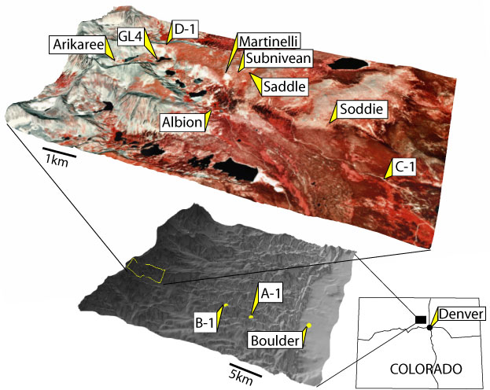
In collaboration with Andy Fox (U. Arizona) An experiment at Niwot Ridge
9.7 km east of the Continental Divide
C-1 is located in a Subalpine Forest
(40º 02' 09'' N; 105º 32' 09'' W; 3021 m)
One column of Community Land Model (CLM)
Spun up for 1500 years with site-specific information.
64 ensemble members
Forcing from the DART/CAM reanalysis,
Assimilating tower fluxes of latent heat (LE), sensible heat (H), and net ecosystem production (NEP).
Impacts CLM variables: LEAFC, LIVEROOTC, LIVESTEMC, DEADSTEMC, LITR1C, LITR2C, SOIL1C, SOIL2C, SOILLIQ … all of these are unobserved.

Slide 43
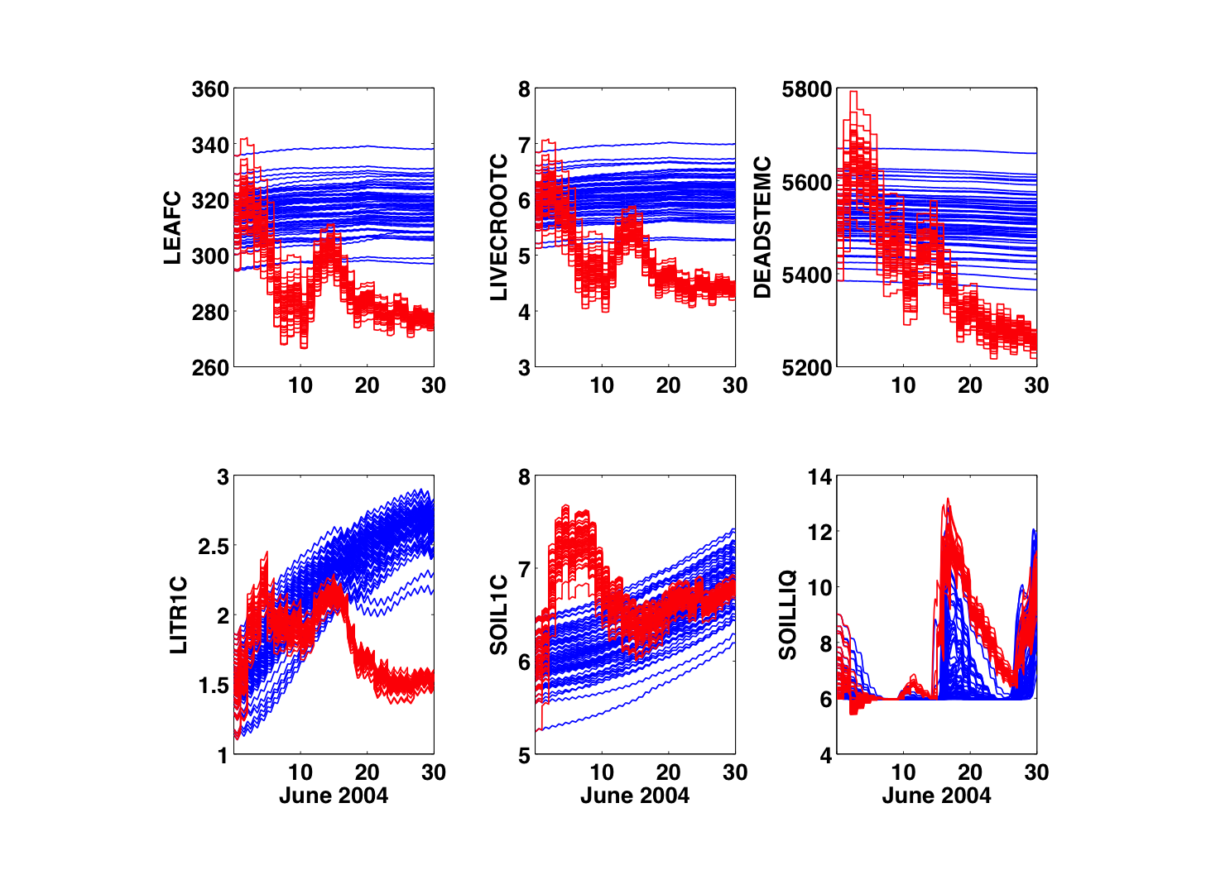
These are all unobserved variables.
Free Run
Assim
June 2004

Slide 44
Challenges for Earth System Models (CLM examples)
Additional challenges:
Model variable definitions with non-Gaussian distributions,
Creating unobserved things.
Snow example, If prior has no snow, but observations do:
Must partition snow amongst five layers, normally depends on history of snowfall. Highly non-Gaussian,
Must assign age, dust content, ice content, … to each layer.

Slide 45
Challenges for Earth System Models (CLM examples)
Additional challenges:
Observations with poor error characterization,
Short periods of observations compared to system timescales.

Slide 46
Promising Research Directions
Just do it. Can get useful results by ignoring the problems.
Try new models and observations.
Develop more appropriate models for prediction applications.
(with modelers)
Explore value of existing or proposed observations.
(with observation folks)
Apply novel techniques for parameter estimation.
(with statisticians)
Identify new important quantities that might be predicted.
(with impacts folks)

Slide 47



Learn more about DART at POSTER 171 TODAY
www.image.ucar.edu/DAReS/DART
dart@ucar.edu
Anderson, J., Hoar, T., Raeder, K., Liu, H., Collins, N., Torn, R., Arellano, A., 2009: The Data Assimilation Research Testbed: A community facility.
BAMS, 90, 1283—1296, doi: 10.1175/2009BAMS2618.1

Slide 48
Identifying Model Systematic Errors
Prediction Model
Observing System
Identify
Systematic
Errors
Data Assimilation
Analysis
Diagnostics

Slide 49
DART Science and Collaborators (4)
Science: Diagnosing and correcting errors in the CAM FV core.
Collaborator: Peter Lauritzen, CGD.

Slide 50
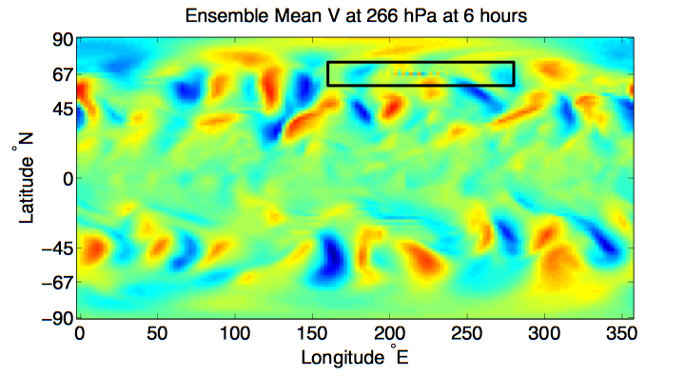
DART Science and Collaborators (4)
Gridpoint noise detected in CAM/DART analysis
CAM FV core - 80 member mean - 00Z 25 September 2006

Slide 51
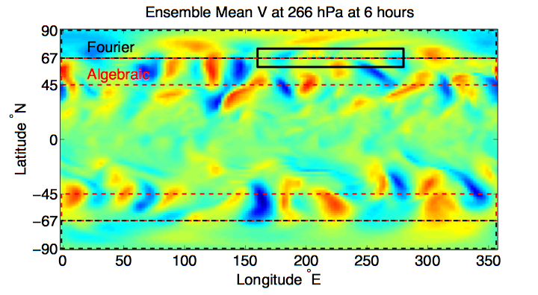
DART Science and Collaborators (4)
Suspicions turned to the polar filter (DPF)
CAM FV core - 80 member mean - 00Z 25 September 2006

Slide 52
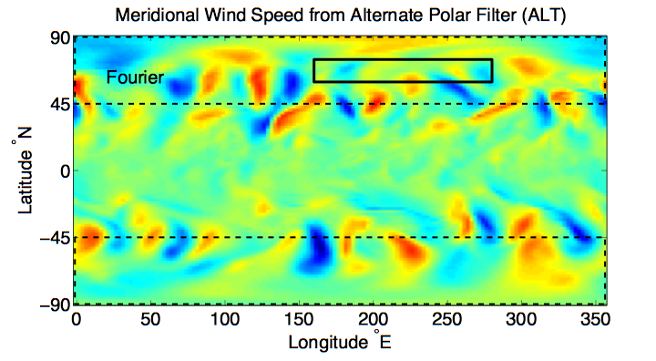
DART Science and Collaborators (4)
Continuous polar filter (alt-pft) eliminated noise.

Slide 53
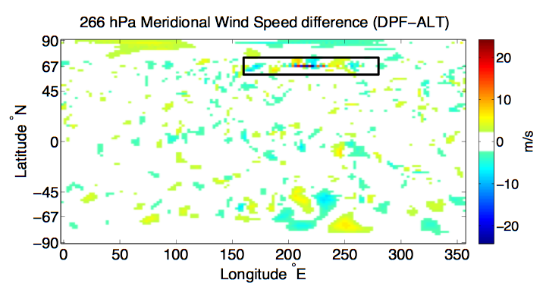
DART Science and Collaborators (4)
Differences mostly in transition region of default filter.

Slide 54
DART Science and Collaborators (4)
The use of DART diagnosed a problem that had been unrecognized (or at least undocumented).
Could have an important effect on any physics in which meridional mixing is important.
The problem can be seen in ‘free runs’ - it is not a data assimilation artifact.
Without assimilation, can’t get reproducing occurrences to diagnose.

